Slide 1

Decorrelation of Humidity and Temperature in Chemical Sensors For Continuous Monitoring
By
Devish Mundra
Cyber Physical Systems CSCI 5800-001

Slide 2
Motivation
Chemical sensors are sensitive to humidity and temperature.
Cross-sensitivity challenges the task of identifying and quantification of violations in uncontrolled scenarios .
To build a model that predicts the changes in the sensor conductance as a function of humidity and temperature variations.

Slide 3
Model
Obtain gas sensor data from a sensing device
Preprocess the sensor data
Input the preprocessed data in to a machine learning model (Artificial Neural Network)
Receive predicted discrimination among banana, wine, baseline response as output from the machine learning model

Slide 4

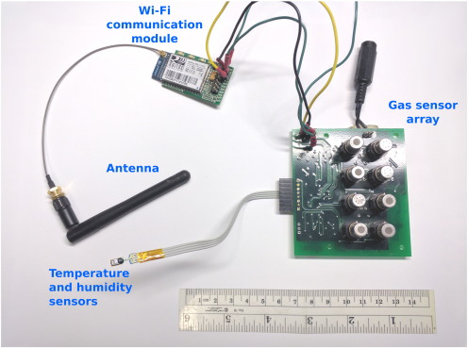



Data Collection
Data has been obtained from UCI Machine Learning Repository
Dataset has recordings of a gas sensor array composed of 8 MOX gas sensors, and a temperature and humidity sensor.
This sensor was exposed to background home activity while subject to two different stimuli: wine and banana

Slide 5
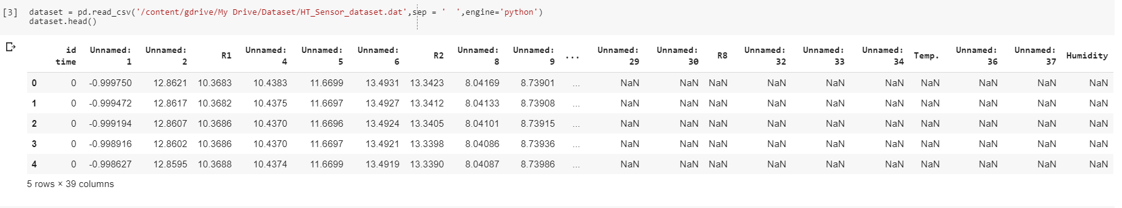
Data Preprocessing

Slide 6
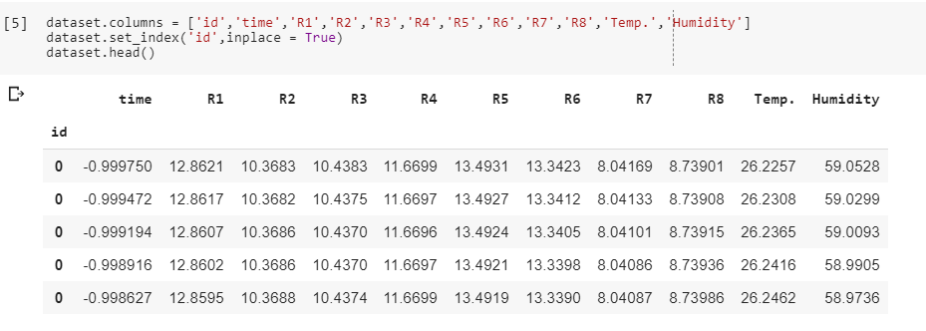
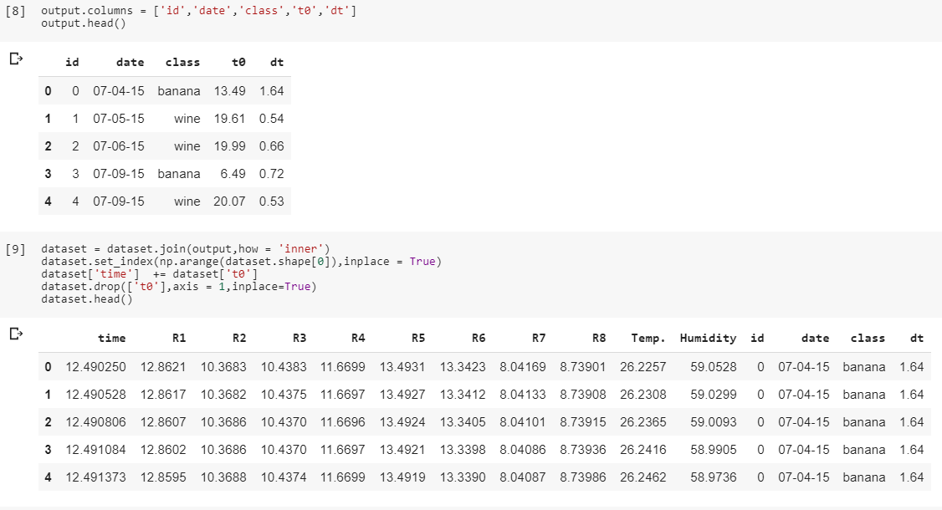
Data Preprocessing

Slide 7
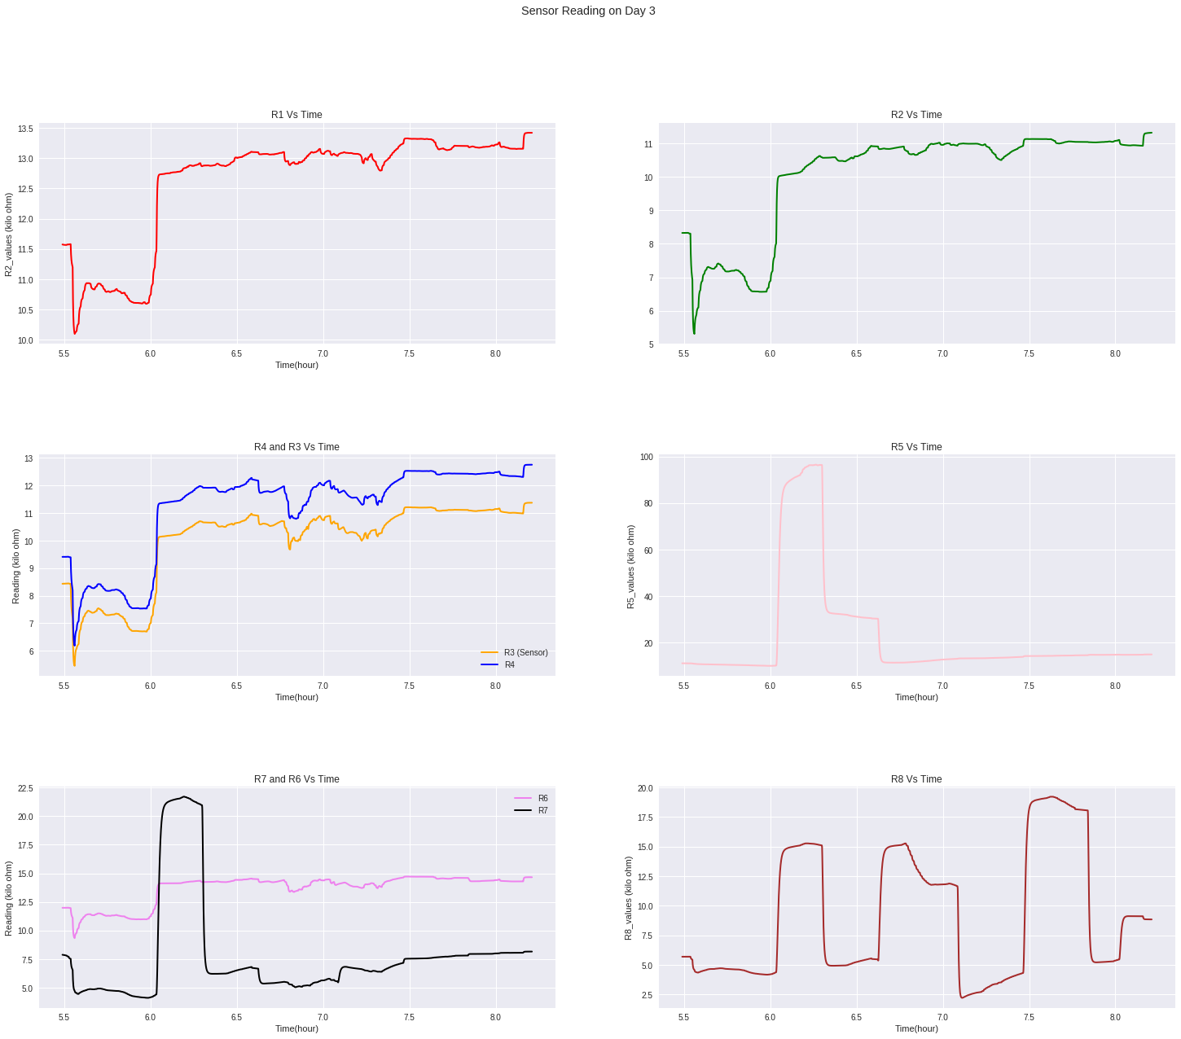
Data Visualizing

Slide 8
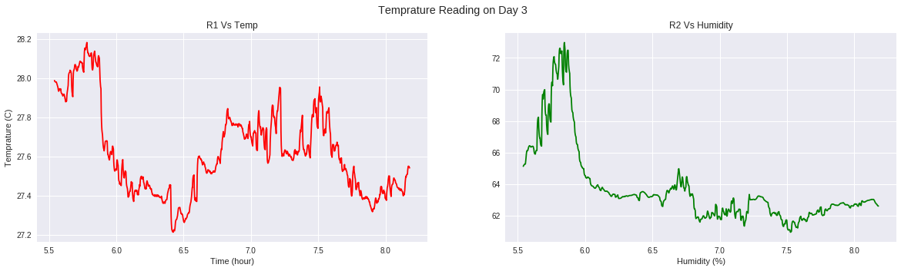
Data Visualizing

Slide 9
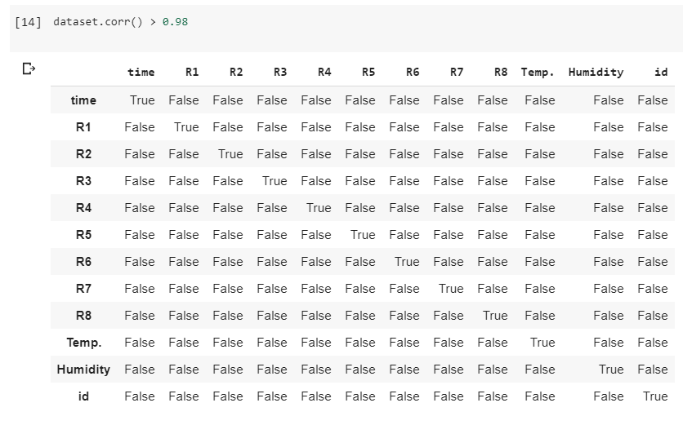
Data Preprocessing

Slide 10
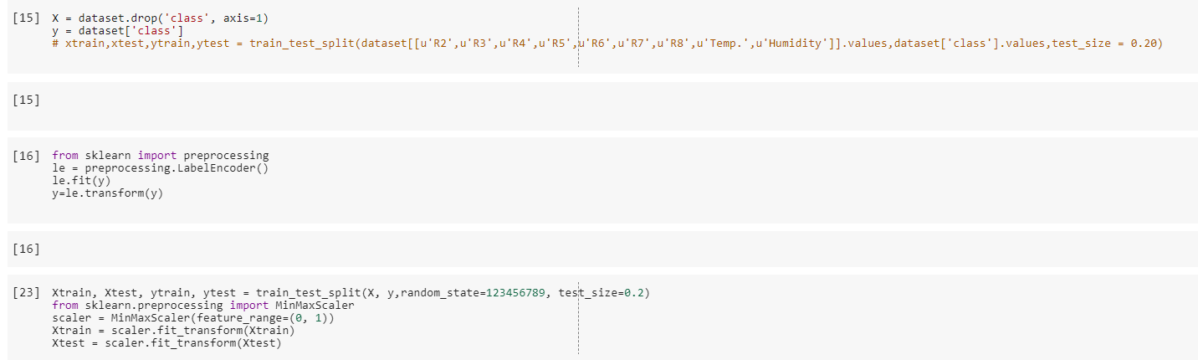
Data Preprocessing

Slide 11
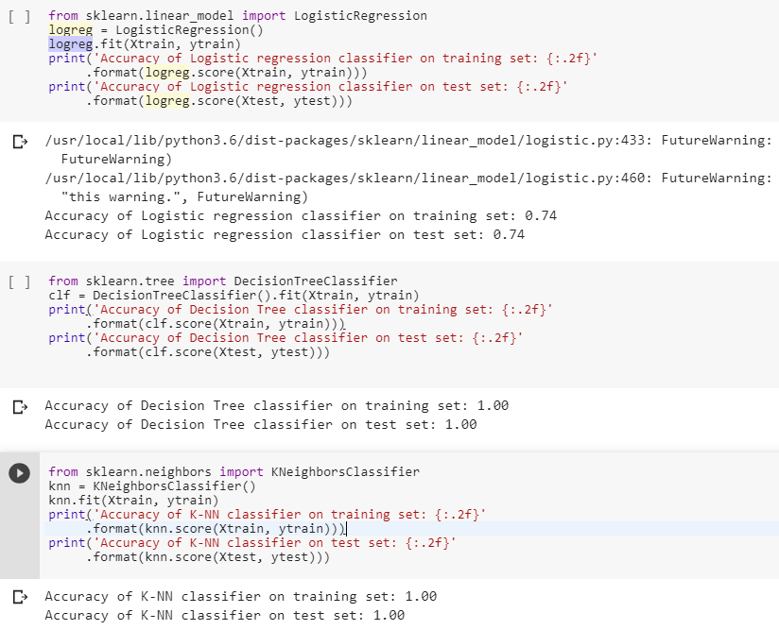
Model Exploration

Slide 12
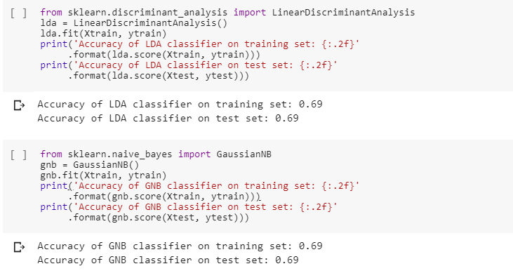
Model Exploration

Slide 13
Any Different Approach?

Slide 14
Let’s try Neural Network

Slide 15
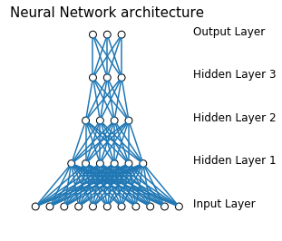
ANN Exploration

Slide 16

ANN Exploration

Slide 17
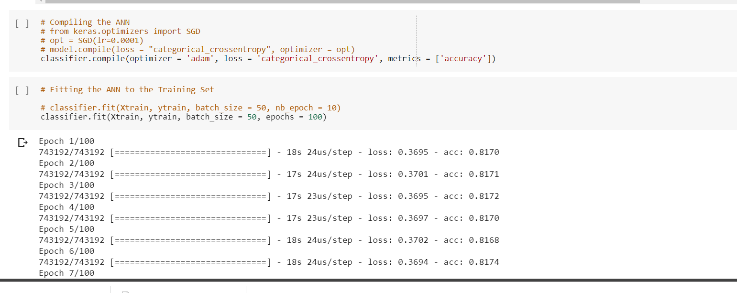
ANN Exploration

Slide 18
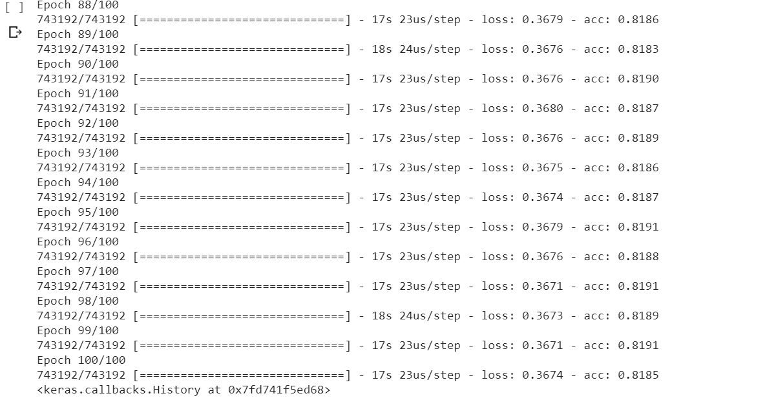
ANN Exploration

Slide 19
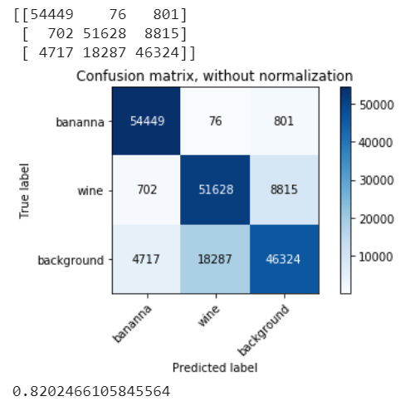
ANN Exploration

Slide 20







Tools Used

Slide 21
Conclusion
We can confirmed that the most statistically significant factors are humidity changes and correlated changes of temperature and humidity
To show how the humidity–temperature correction model works for gas discrimination, we constructed a model for online discrimination among banana, wine and baseline response.
This shows that pattern recognition algorithms improve performance and reliability by including the filtered signal of the chemical sensors.

Slide 22
References
Online decorrelation of humidity and temperature in chemical sensors for continuous monitoring https://doi.org/10.1016/j.chemolab.2016.07.004
[1] N. Barsan, U. Weimar, Conduction model of metal oxide gas sensors, J. Electroceram. 7 (3) (2001) 143–167.
[2] N. Barsan, U. Weimar, Understanding the fundamental principles of metal oxide based gas sensors; the example of CO sensing with SnO2 sensors in the presence of humidity, J. Phys. Condens. Matter 15 (20) (2003) R813.

